Slide 1
Politics & Pre-Existing Divides Effects on Covid-19
Presentation by “Group Sixers”
To GWU Data Boot Camp Class
November 14, 2020

Slide 2
“Group Sixers” Team
Adrian Salas
Brooke Cooper
Marilou Francis
Steven Rigby
Henry Tran
Joseph Verghese
”Better Living Through Data… Lots of It!”

Slide 3
Questions
Are politics coloring reporting on the pandemic’s true death toll at the state level?
How are politics affecting unemployment in the face of pandemic at the state level?
How are politics affecting bankruptcies in the face of pandemic at the state level?
Is the pandemic differentially impacting on the basis of race and ethnicity for the entire country?
Also, how is the pandemic affecting long-term unemployment rates for the entire country?

Slide 4
Why Pursue These Questions?
Grim failure to manage the pandemic well in the US, thus far
Highly polarized political environment, with a major election that took place in the same year the pandemic hit US shores
The pandemic is clearly stressing the country economically
The pandemic seems to be magnifying the effects of pre-existing disparities on the basis of race and ethnicity (income, access, etc.)

Slide 5
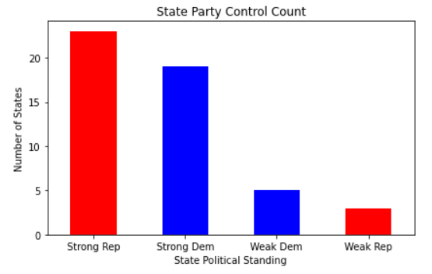
Does a state’s partisan control affect reporting of true number of Covid-19 deaths?
2 variables:
Partisan control at state level
Percentage of Under-Reported Covid-19 deaths, based on:
Total positively identified Covid-19 deaths
Excess deaths beyond expected number, excluding known Covid-19 deaths
Do Republican-controlled states under-report the true total death count related to Covid-19?
If true, might the reasons be about holding onto political control?
Sources:
Unemployment claims by state.csv - https://oui.doleta.gov/unemploy/claims.asp
Covid cases by state.csv - https://catalog.data.gov/dataset/united-states-covid-19-cases-and-deaths-by-state-over-time

Slide 6
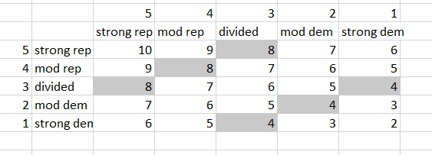
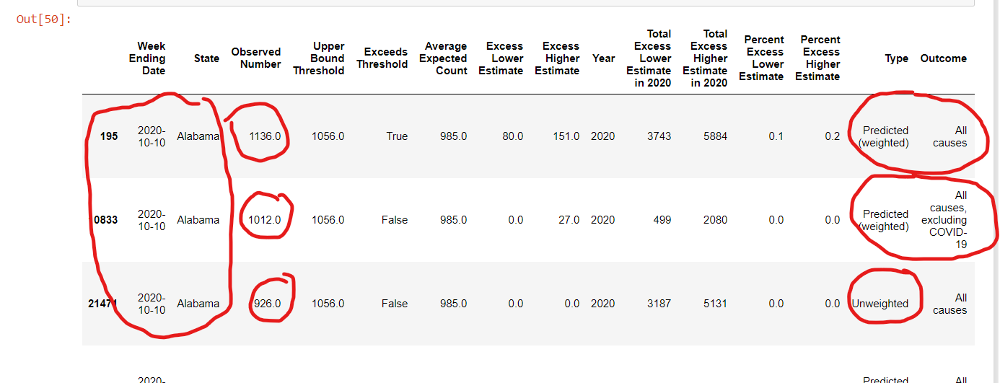
Data Cleanup & Exploration
Compile data:
Import and read CSVs
Merge CSV, Excel, and PDF into 1 data frame
Change any Nan values to 0, etc.
Processing data for analysis:
Established code worked for one state
For loops to extract for all states
Used multiple methods to characterize data and verify analysis
Used table to compute value for political control at the state level as a dictionary
*One column had 3 values for same date*
*Used Tabula to import pdf data*
*Required to split data cells on pdf import*

Slide 7
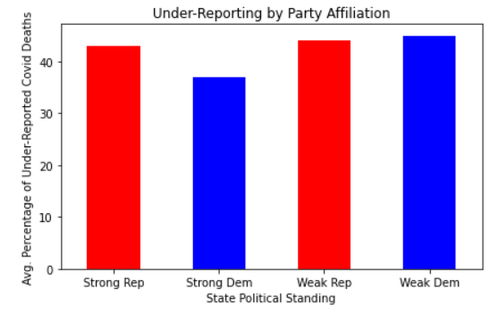
Covid-19 Deaths Reporting Analysis
We summed the probable true number of Covid-19 deaths by state
Strongly Republican states under-reported
Strong Democratic states by 6% Points
- Avg for 23 Rep Controlled States = 43%
- Avg for 19 Dem Controlled States = 37%
- Avg for 8 Divided Control States = 45%
If our hypothesis is right, strongly Rep should be greater than strongly Dem, and Divided should come inbetween.
NOT what we found, however
Definition: Probable Total Covid-19 Deaths = Known Covid-19 Deaths + Excess Deaths excl. C-19
Excess Deaths is computed based on expected number of deaths had there been no pandemic, weighted for population growth and seasonality and excluding known (positively identified) Covid-19 Deaths

Slide 8
Under-Reporting Not Correlated to State Party Alignment
Based on the data, we can infer:
Strongly Dem vs. Strongly Rep differences don’t come across as so dissimilar as to warrant a charge of rampant systematic underreporting owing to political partisanship.
Moreover, Divided States coming in higher than Strongly Rep indicate no correlation at all
These findings are NOT in line with our speculation

Slide 9
Additional Considerations Covid-19 Deaths
It’s important to recognize that some states with strong partisan control of the government may nonetheless have large constituencies aligned with the party out of power. So, the magnitude of partisan splits may in reality be not that great.
Further, the health systems that collect such data are really not all that partisan. The primary way to skew the data to under-report would be to skew the methodology of how you capture the data in the first place. And it is worth noting these systems were in place prior to the current pandemic.
Also notable, during periods of intensive pandemic spreading in “blue states” early on, health systems weren’t as careful in reporting on patients who were already dead than with paying attention to those still living.
Not least, Excess Deaths might necessarily capture say cancer as primary cause due to the deceased failing to go in for diagnosis or treatment because they were worried about Covid-19. Or captures deaths due to a disease other than Covid-19 but where the deceased’s health was fatally weakened in the wake of a Covid-19 infection.
Such issues can hardly be said to reflect willful misrepresentation on anybody’s part. So, we infer that the count may more likely represent issues with reporting systems that provide only one entry for cause of death.
It is doubtful that our findings will change over a longer period given that in under 70 days, there will be a new government in the White House with stated goals of arresting the pandemic and cooling political polarization.

Slide 10
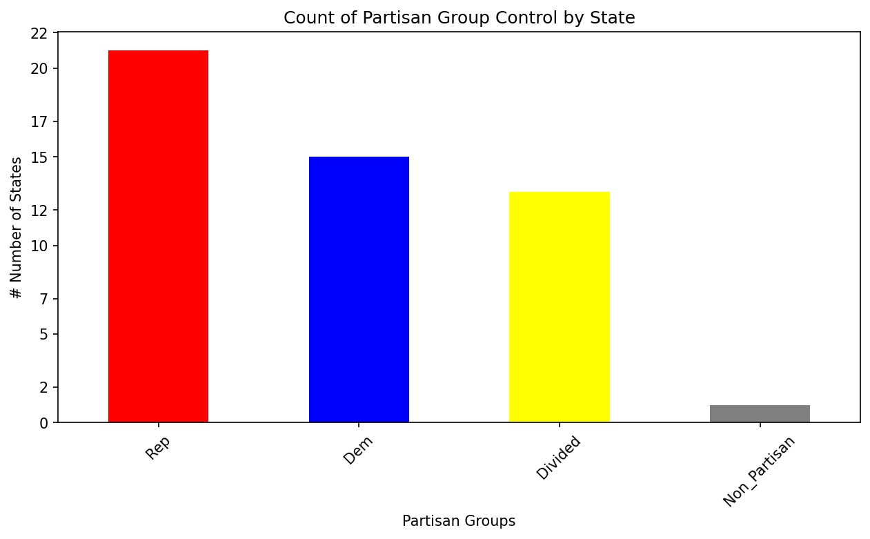
Does a state’s partisan control impact short term unemployment during Covid-19?
3 variables:
Partisan control at state level
Number of Covid-19 cases
New cases per 100,000 (avg per state)
Unemployment rate
Insured Unemployment Rate (avg rate per state)
“The number of people currently receiving unemployment insurance (UI) as a percentage of the labor force.” - stlouisfed.org
Is the partisanship of a state correlated to the state’s unemployment rate?
Can we correlate the number of covid-19 cases to the unemployment rate?
Sources:
Unemployment claims by state.csv - https://oui.doleta.gov/unemploy/claims.asp
Covid cases by state.csv - https://catalog.data.gov/dataset/united-states-covid-19-cases-and-deaths-by-state-over-time

Slide 11
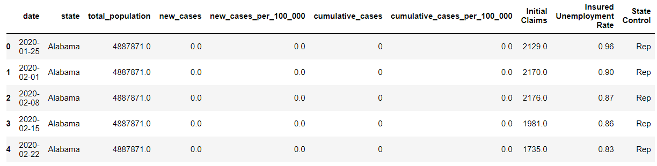
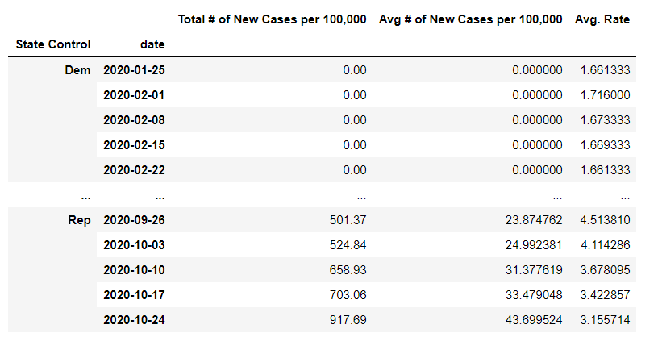
Data Cleanup & Exploration
Compile data:
Import and read CSVs
Merge CSV’s together into 1 data frame
Change any Nan values to 0, along with user friendly column labels
Format data for analysis:
Group the combined df by partisanship and date to track over time
Apply the ‘mean’ functions to the columns of interest
New cases per 100,000
Avg unemployment rate
*‘Sum’ vs ‘Mean’ function*
* ‘Cumulative’ vs ‘New’ cases*

Slide 12
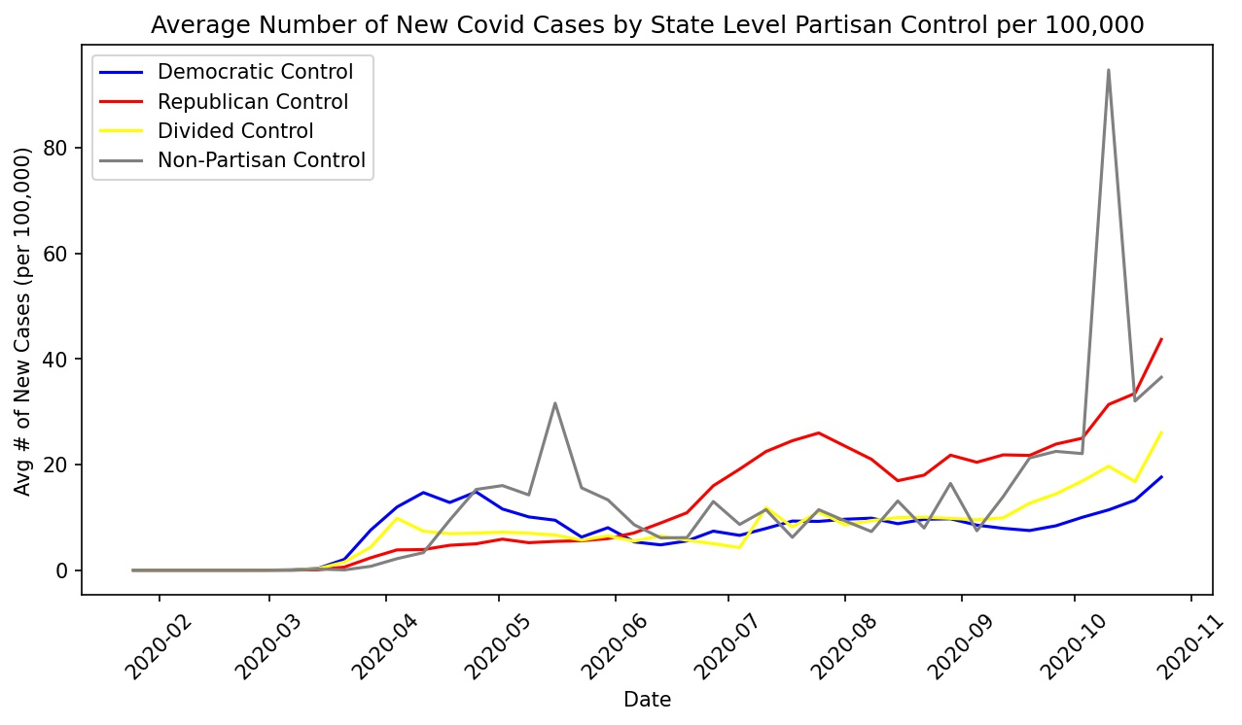
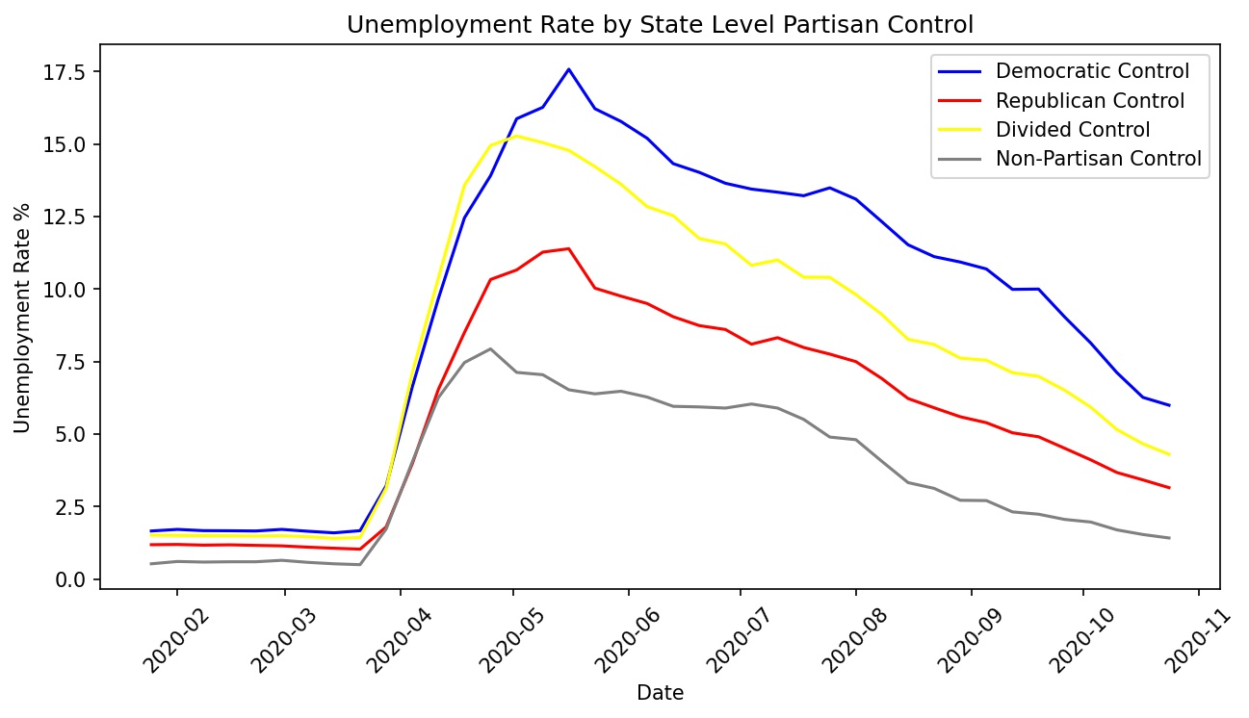
Insured Unemployment Analysis
In the top graph, we analyzed the average number of new covid cases per month
Democratic states had higher rates in the earlier months
Republican states had higher rates in the later months, including a current strong upward trend
In the bottom graph, we analyzed the average insured unemployment rate per month
Democratic states experienced higher rates of unemployment
Republican states experienced lower rates of unemployment

Slide 13
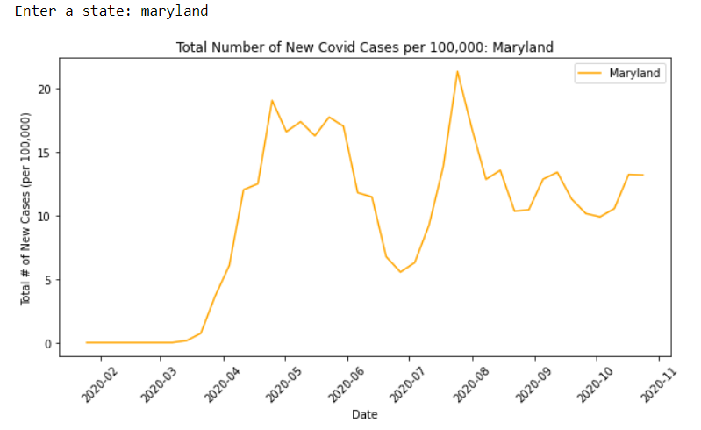
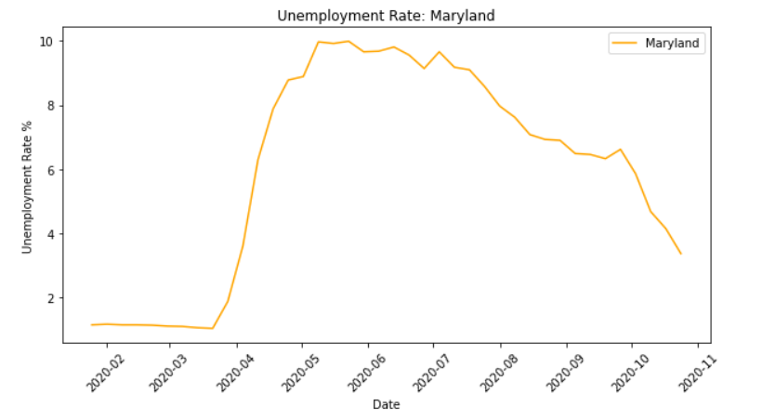
Analysis at State Level
Taking our analysis one step further, we created code for the user to input a specific state
- The plots are easily updatable for each state
We plotted the same data variables for that specific state

Slide 14
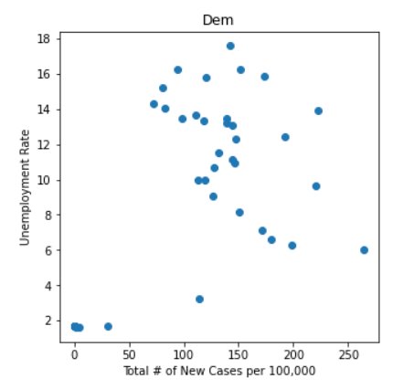
Unemployment Implications
Based on the data, we can imply:
Democratic states took a more direct / cautious approach to the fight against covid
Stronger shut downs and regulations
Republican states took an approach less disruptive to businesses
These findings are in line with our expectations, as well as the general partisan political views
Other considerations:
Did Democratic states open more testing sites opposed to republican states?
Were there actually harder written policies set in place for democratic states?
Difficulty plotting scatter plots, as time seems to be a huge factor

Slide 15
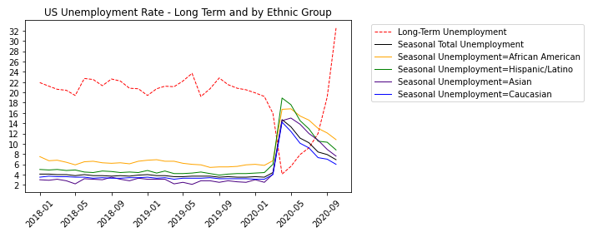
Unemployment: Long Term vs Seasonal - 1 -
Seasonal Unemployment trends depict the dramatic increase covered since the start of the pandemic.
Of all the Ethnic groups, the African American and Hispanics groups have been the most affected.
Alarmingly though, Long-Term Unemployment, which covers those unemployed for at least 27 weeks, has accelerated, going up by 8-fold.
Rising long-term unemployment impacts the broader economy.

Slide 16
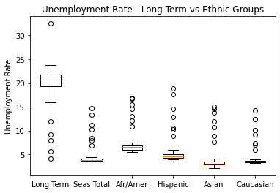
Unemployment: Long Term vs Seasonal - 2 -
From the boxplot, the outliers represent the Y2020 unemployment numbers.
It may be inferred that exogeneous shocks to the economy result in considerable erratic variations in fundamental economic measures.
The question is how long do we see these as outliers, or if they become the norm.

Slide 17
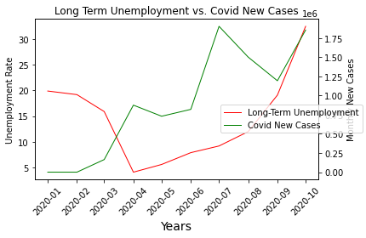
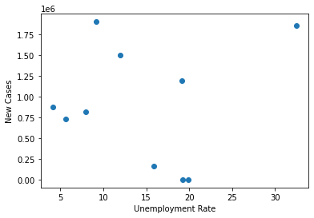
Long Term Unemployment vs Covid Increase
We attempted to establish the correlation between long-term unemployment vs Covid New Cases using monthly data.
Simply plotted, both are on an upward trend.
However, the scatter plot exhibits very wide dispersion, possibly because:
1. data is monthly (long-term unemployment is available only on a monthly basis)
2. There is no depth to the data as only 10 sets of monthly data is tracked.

Slide 18
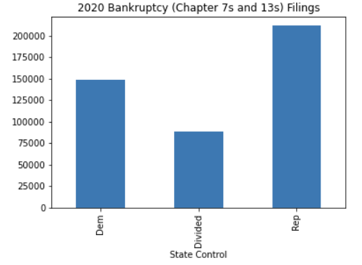
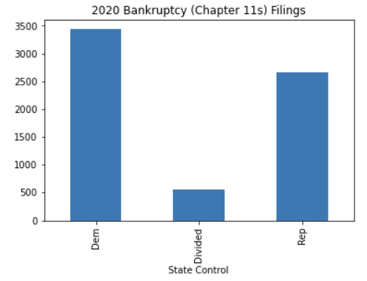
Does a state’s partisan control impact bankruptcy filings during Covid-19?
3 variables:
Partisan control at state level
Observing period before and after pandemic begins
Combined Chapter 13 and 7 bankruptcies
First analysis by total bankruptcies
Second analysis by average bankruptcy rates per 100,000
Have Republican controlled states faired better or worse through the pandemic?
And if so, can we infer why?
Sources:
13 and 7 bankruptcy filings by state.csv - https://www.abi.org/newsroom/bankruptcy-statistics
Partisan control.pdf - https://www.ncsl.org/Portals/1/Documents/Elections/Legis_Control_2020_April%201.pdf

Slide 19
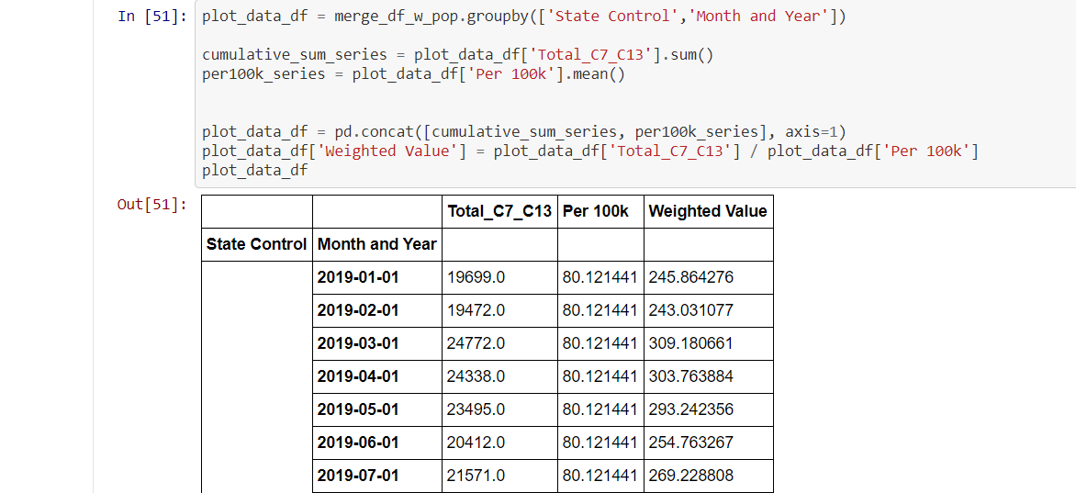
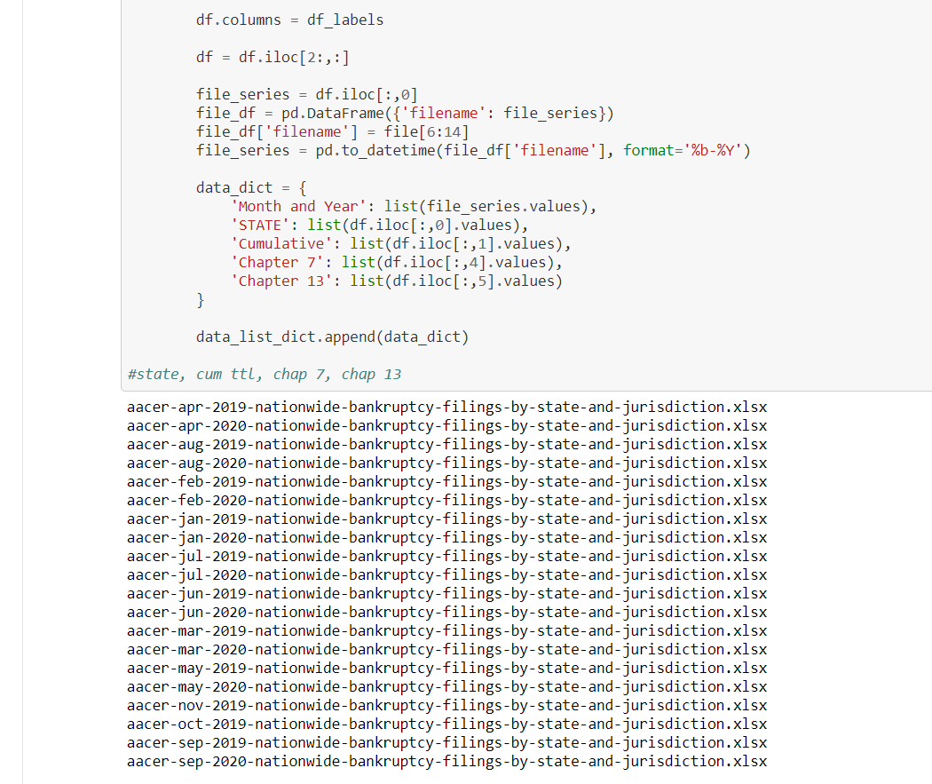
Data Cleanup & Exploration
Compile data:
For loop import and read 20+ Excel files
Extract and paste monthly commulative data into an empty dataframe
Convert cumulative data using .diff() and .replace() null and negatives with correct
Merge bankruptcy, state control, and census datasets
Format data for analysis:
Groupby by state control
Apply the ‘mean’ functions to the columns of avg bankruptcies per 100k
*For loops to traverse dataset relatively large scale*
*Engineer around groupby limitations*
*Many decisions about when to merge or append or extract to wholly new dataframe*

Slide 20
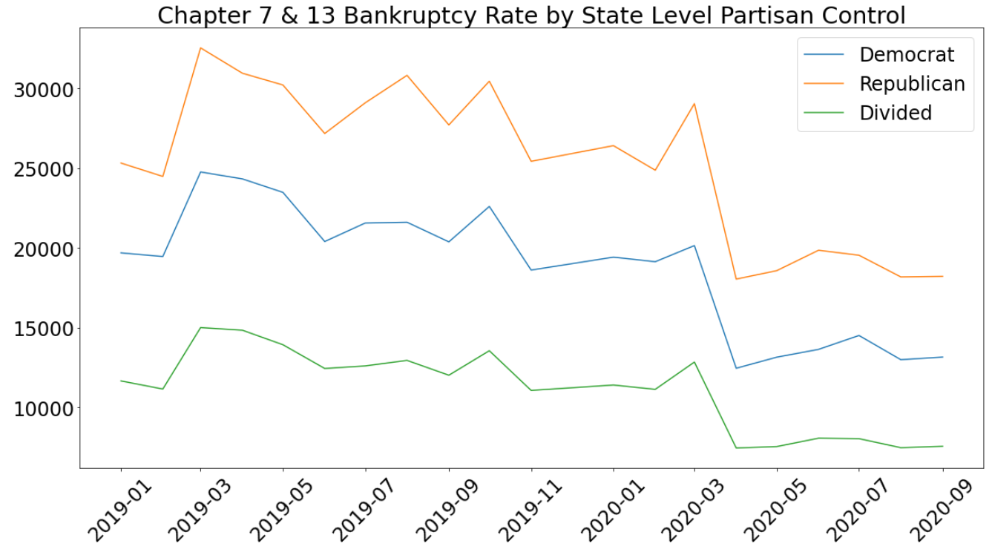
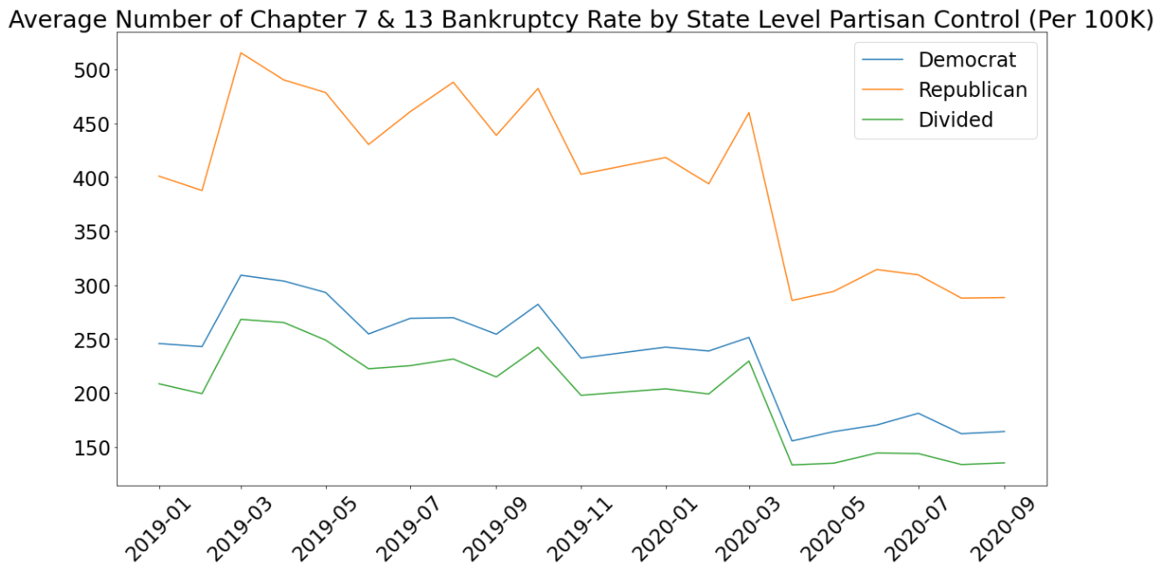
Chapt 7 and 13 Bankruptcy Analysis
In the top graph, we analyzed the total numbers of BKs for clusters of states by party alignment
Rep states tracked higher, Dem states tracked the middle throughout
Covid affected them equally on a relative basis
All clusters experienced decline bankruptcies begin with Covid
In the bottom graph, we analyzed the average bankruptcy filings rate per 100k
Dem + Div states tracked more closely
Rep states tracked higher than Dem or Div

Slide 21
Chap 13 & 7 Bankruptcy Implications
Based on the data, we can infer:
The advent and continued presence of the pandemic seems to have provided a pause in the number of Chapter 13 and 7 bankruptcies.
Covid stimulus may have staved off urgency
Courts shut down or slowed, affecting bankruptcy processing
The disparity of bankruptcies in Rep states vs. the rest may reflect rust belt and rural economics, or financial literacy and related social issues.
These findings were not expected. We thought the pandemic economic disruption might affect blue vs. red states differentially.

Slide 22
Conclusions and Impact
State level political affiliation
Correlates to rates of new infection
Correlates to unemployment rates
Does not correlate to under-reporting Covid-19 deaths
Does not correlate to Chapter 7 and 13 bankruptcies
Pandemic initially correlated equally by race and ethnicity, but more recently seems to have impacted minorities more disproportionately
Pandemic is greatly accelerating long-term unemployment rates

Slide 23
Difficulties and Further Considerations
Multiple factors we were unable to measure for
Not enough time to time slice for leading and lagging indicators
We would like to have had enough time to perform more variance and standard deviation analysis

Slide 24
Questions?

